Slide 1
Project Title: WhatsApp Weather Bot
Problem Statement |  | Team Members
Weather changes suddenly and can be dangerous. People often overlook the danger of weather related risks due to its ‘natural occurrence’. |  | Sponsor: Tan Chee Keong
Current Situation |  | Leader: Chin Joo Ern
Weather can be difficult to predict and monitor. Keeping an eye on NEA’s weather satellites data can be cumbersome, while registering for the updates can be a hassle. Additionally, the weather updates are not specifically catered to SMRT’s work zones (Mainline Network in this context). There is no SMRT-work specific weather update to let the maintenance teams (both the night and day) know that the weather is hazardous.
Proposed Solutions
 |  | Members: Justin Ho
As such, it was deemed worthwhile to write a program which extracts satellite weather data and air pollution data and match it to Singapore’s train network through channels where staff are sure to be informed/monitoring (WhatsApp).
Impact
Tangible benefits ($): Weather consciousness is increased, reducing the risk of SMRT staff succumbing to any weather-related incidents or risks. Server Rental: $200/Month Server Monitoring: $200/Month Low-End Chatbot Operation: $500/Month Low-End Webscraping Set-Up: $150 Low-End Webscraping Management: $100/Month | Intangible benefits: The WhatsApp Bot can be deployed for any other type of updating function. Currently no such function exists aside from TWILIO which has many limitations.

Slide 2
Kaizen Newspaper
Project Title: WhatsApp Weather Bot
S/No | Activities | Champion | Date starts | Date to end | Date Completed | Remarks
1 | Program the WhatApp Weather Bot | Chin Joo Ern | 30/04/19 | 03/05/19 | 03/05/19
2 | Test the WhatsApp Weather Bot | Chin Joo Ern | 04/05/19 | On-going | On-going
3 | Maintain the WhatsApp Weather Bot | Chin Joo Ern | 04/05/19 | On-going | On-going
Project Leader: Chin Joo Ern

Slide 3
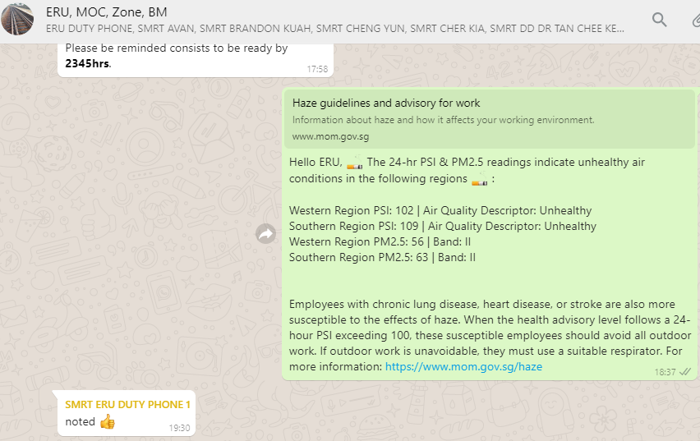
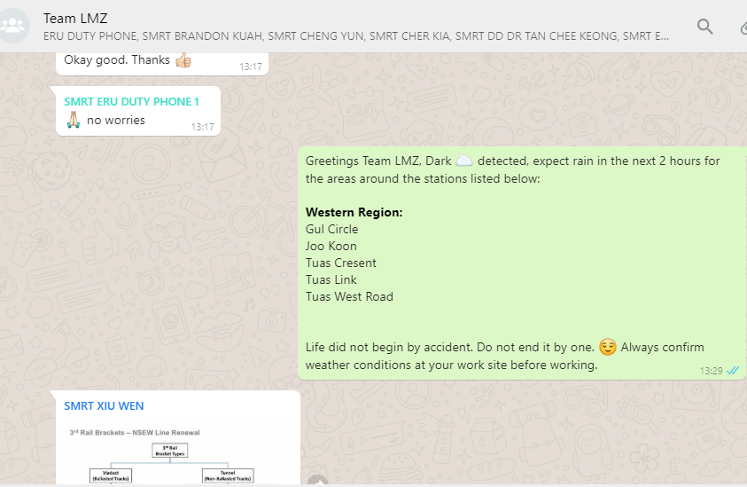
After

Slide 4


